Slide 1

CREATIVE HABITS
http://cdn-media-1.lifehack.org/wp-content/files/2012/07/creativity_habit.jpg

Slide 3
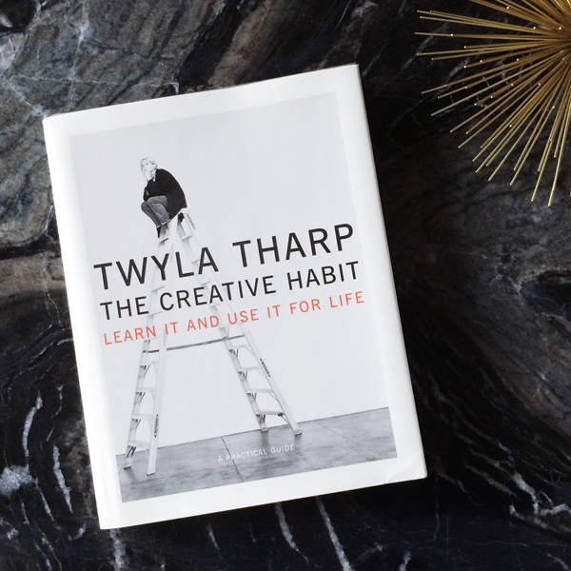
http://www.megbiram.com/wp-content/uploads/2014/03/twyla-tharp-the-creative-habit.jpg

Slide 4
TWYLA HARP CREATIVE HABITS
Rituals of Preparation
Mozart’s Genius
Give Me 1 Week Without
Get Busy Copying
Reading
Stimulate Your Body
Prepare To be lucky
Perfect Practice Makes perfect
Passion + Skill
https://experiencelife.com/wp-content/uploads/2011/11/The-Creativity-Habit-Learn-It-and-Use-It-for-Life.pdf

Slide 5
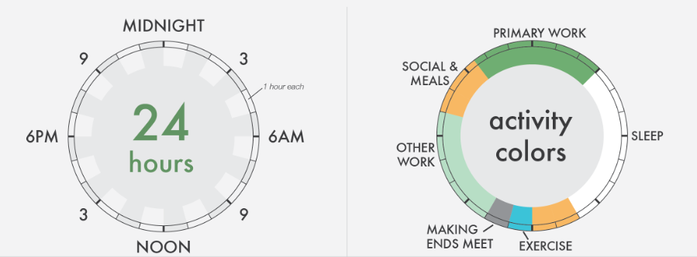
Rituals of Preparation
1
More than anything, this book is about preparation:
In order to be creative you have to know
how to prepare to be creative.
https://infographwetrust.files.wordpress.com/2014/03/creative-routines-edit3.png
Notes:
No one can give you your subject matter, your creative content; if they could, it would be their creation, not yours. But there’s a process that generates creativity—and you can learn it. And youcan make it habitual.”

Slide 6
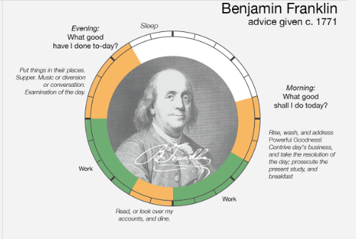

Slide 7
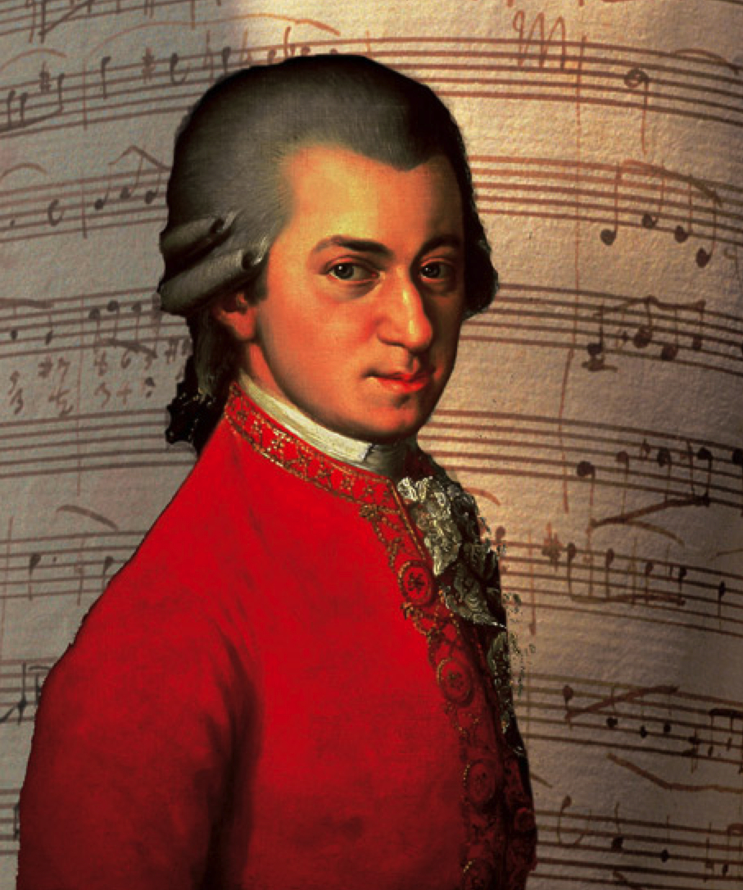
Mozart’s Genius
2
“People who think my art comes easily to me. I assure you, dear friend, nobody has devoted so much time and thought to composition as I. There is not a famous master whose music I have not industriously studied through many times
http://www.thecultureconcept.com/circle/wp-content/uploads/2014/08/Mozart.jpg
Notes:
No one can give you your subject matter, your creative content; if they could, it would be their creation, not yours. But there’s a process that generates creativity—and you can learn it. And youcan make it habitual.”

Slide 8
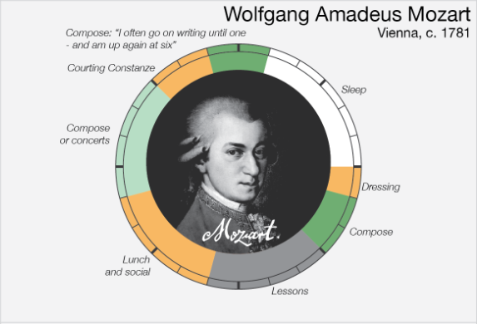

Slide 9

Birth
Genius
Birth
hard work
Genius

Slide 10

Give Me 1 Week Without
3
Take a week off from clutter and distractions.
http://rrmuk.com/wp-content/uploads/2014/03/Busy.jpg
Notes:
No one can give you your subject matter, your creative content; if they could, it would be their creation, not yours. But there’s a process that generates creativity—and you can learn it. And youcan make it habitual.”

Slide 11
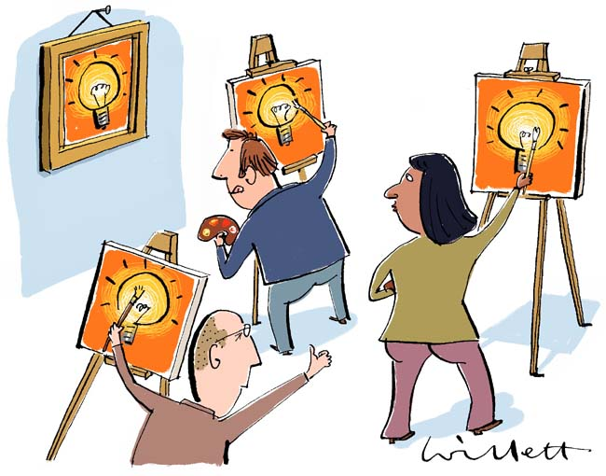
Get Busy Copying
4
“As Freud said, “When inspiration does not come
to me, I go halfway to meet it.””
http://www.willett-ink.co.uk/LGC%20web/images/Copying%20good%20ideas.jpg
Notes:
No one can give you your subject matter, your creative content; if they could, it would be their creation, not yours. But there’s a process that generates creativity—and you can learn it. And youcan make it habitual.”

Slide 12

Reading
5
“If I stopped reading, I’d stop thinking. It’s that simple.”
http://www.idontwannagrowup.com/wp-content/uploads/2010/07/baby-geek-reading-glasses.jpg
Notes:
No one can give you your subject matter, your creative content; if they could, it would be their creation, not yours. But there’s a process that generates creativity—and you can learn it. And youcan make it habitual.”

Slide 13

Stimulate Your Body
6
“...when you stimulate your body, your brain comes alive in ways you can’t simulate in a sedentary position...”
http://under30ceo.com/wp-content/uploads/2013/06/Healthy-Mind.jpg
Notes:
No one can give you your subject matter, your creative content; if they could, it would be their creation, not yours. But there’s a process that generates creativity—and you can learn it. And youcan make it habitual.”

Slide 14
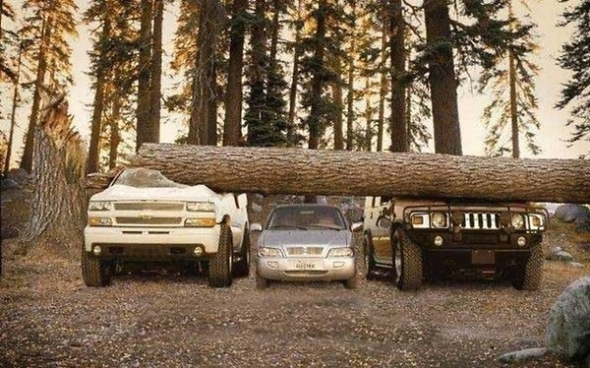
Prepare to be Lucky
7
You don’t get lucky without preparation,
and there’s no sense in being prepared if you’re not open to the possibility of a glorious accident.”
http://cl.jroo.me/z3/Z/F/v/e/a.baa-this-is-one-very-lucky-car-l.jpg
Notes:
No one can give you your subject matter, your creative content; if they could, it would be their creation, not yours. But there’s a process that generates creativity—and you can learn it. And youcan make it habitual.”

Slide 15
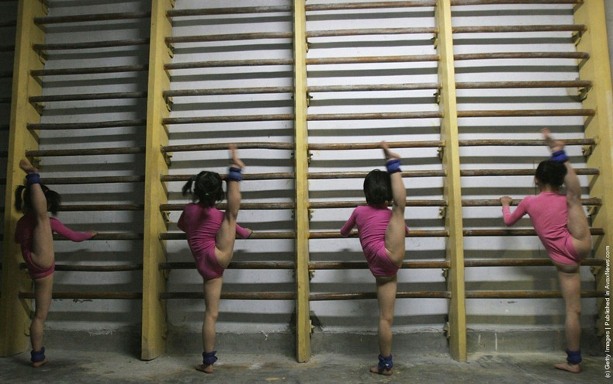
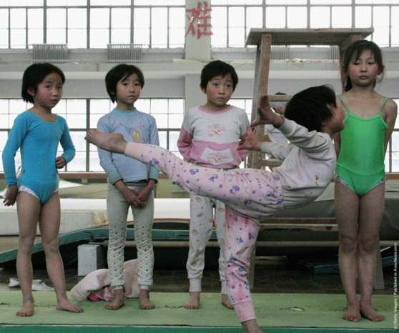
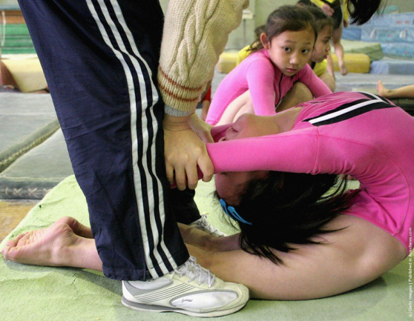
Perfect Practice Makes perfect
8
Confidence is a trait that has to be earned honestly and refreshed constantly; you have to work as hard to protect your skills as you did to develop them
https://mindborrower.wordpress.com/2013/07/05/the-story-of-shichahai-sports-academy/
Notes:
No one can give you your subject matter, your creative content; if they could, it would be their creation, not yours. But there’s a process that generates creativity—and you can learn it. And youcan make it habitual.”

Slide 16

Passion + Skill
9
Without passion, all the skill in the world won’t lift you above craft. Without skill, all the passion in the world will leave you eager but floundering. Combining the two is the essence of
the creative life
http://www.ferociousstrength.com/wp-content/uploads/2012/04/Alex-Honnold-Free-Solo-Climbing.jpg
Notes:
No one can give you your subject matter, your creative content; if they could, it would be their creation, not yours. But there’s a process that generates creativity—and you can learn it. And youcan make it habitual.”

Slide 17
TWYLA HARP CREATIVE HABITS
Rituals of Preparation
Mozart’s Genius
Give Me 1 Week Without
Get Busy Copying
Reading
Stimulate Your Body
Prepare To be lucky
Perfect Practice Makes perfect
Passion + Skill

Slide 18

http://abcofsuccess.com/wp-content/uploads/2014/06/xxx_twyla_tharp-e1401982665763.jpg

